Slide 1
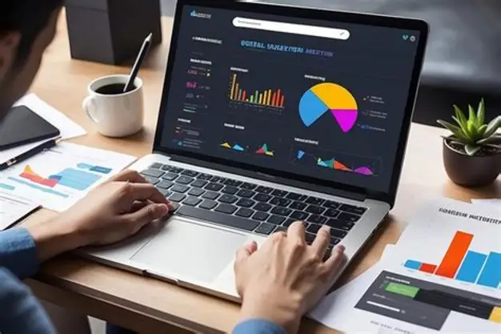



F
FOUR CODERS
Monthly Expense Analysis
Guided by
1. Supriya
2. Ritika Maurya
3. Shivangi Mishra
4. Divya Mishra1
Shailesh Yadav

Slide 2
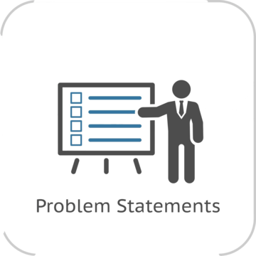
Problem Statement
Managing monthly expenses can be difficult because spending is divided into different categories such as food, travel, shopping, bills, and entertainment. Analyzing expense data can help identify spending patterns, major expense categories, and monthly changes in expenditure.

Slide 3
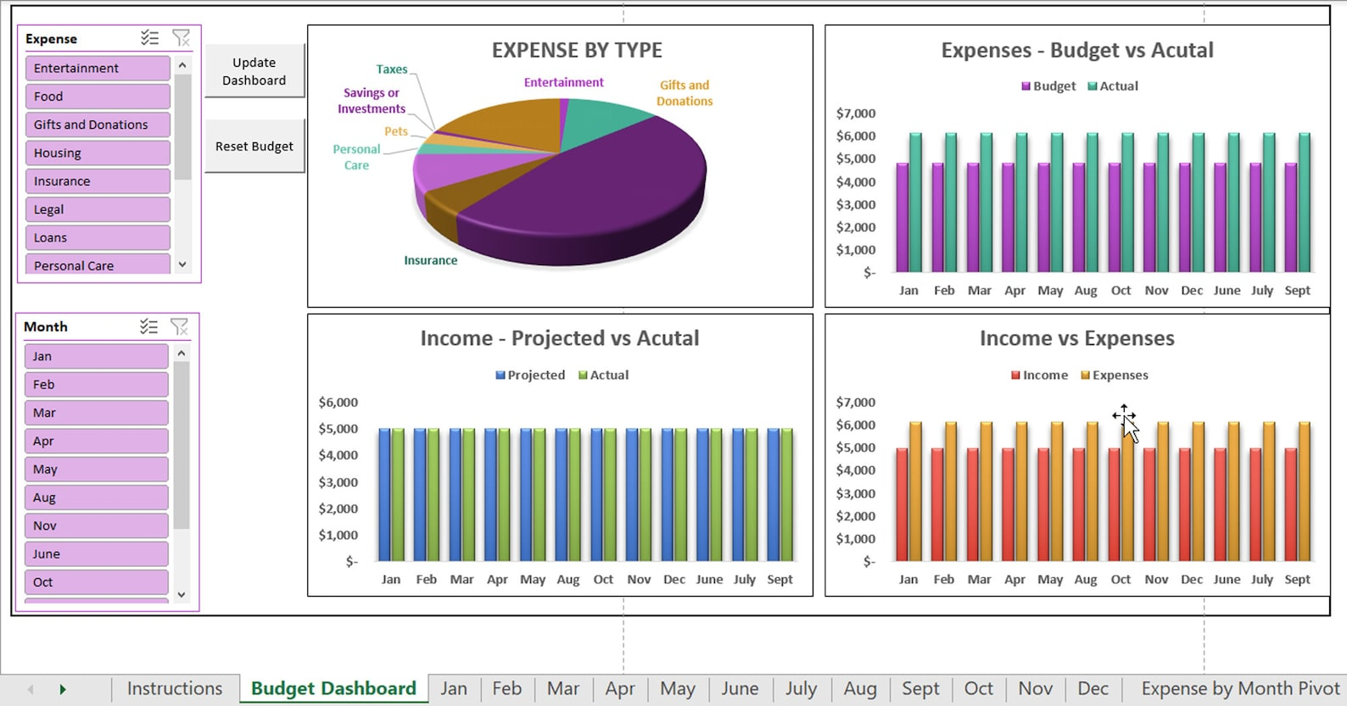
Solution
Use MS Excel to organize and analyse monthly expense data.
Categorize expenses into Food, Travel, Shopping, Bills, and Entertainment.
Calculate total and category-wise expenses.
Compare monthly expenses to identify spending patterns and changes.
Use charts and graphs to visualize the data.
Identify major expense categories and areas where spending can be better managed.

Slide 4
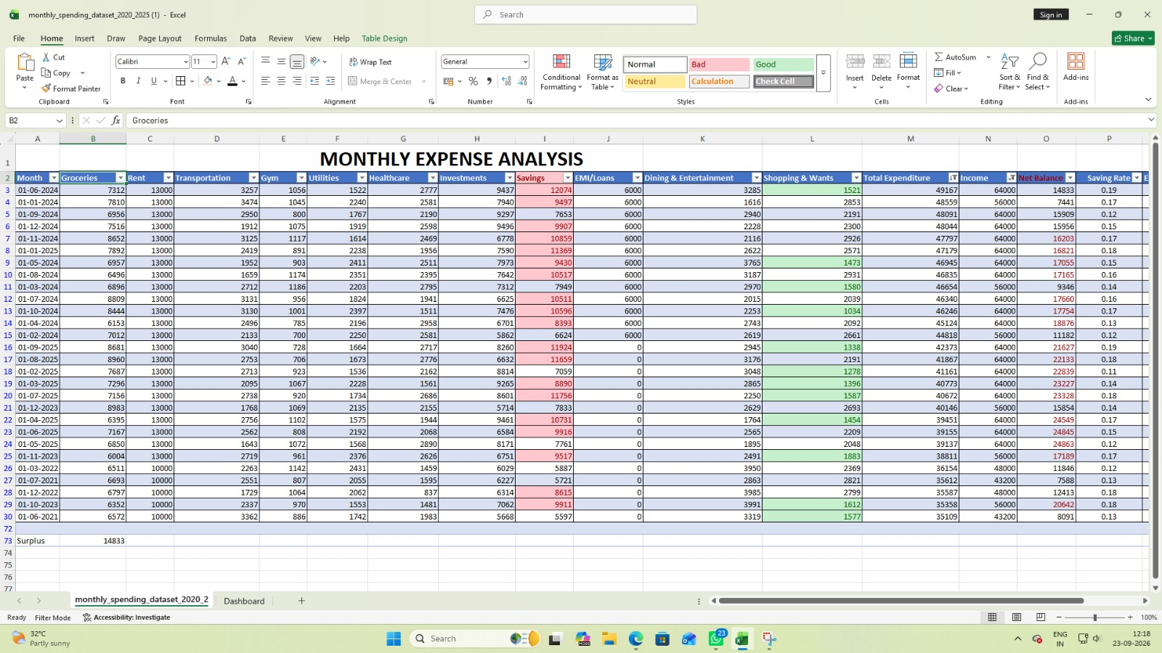
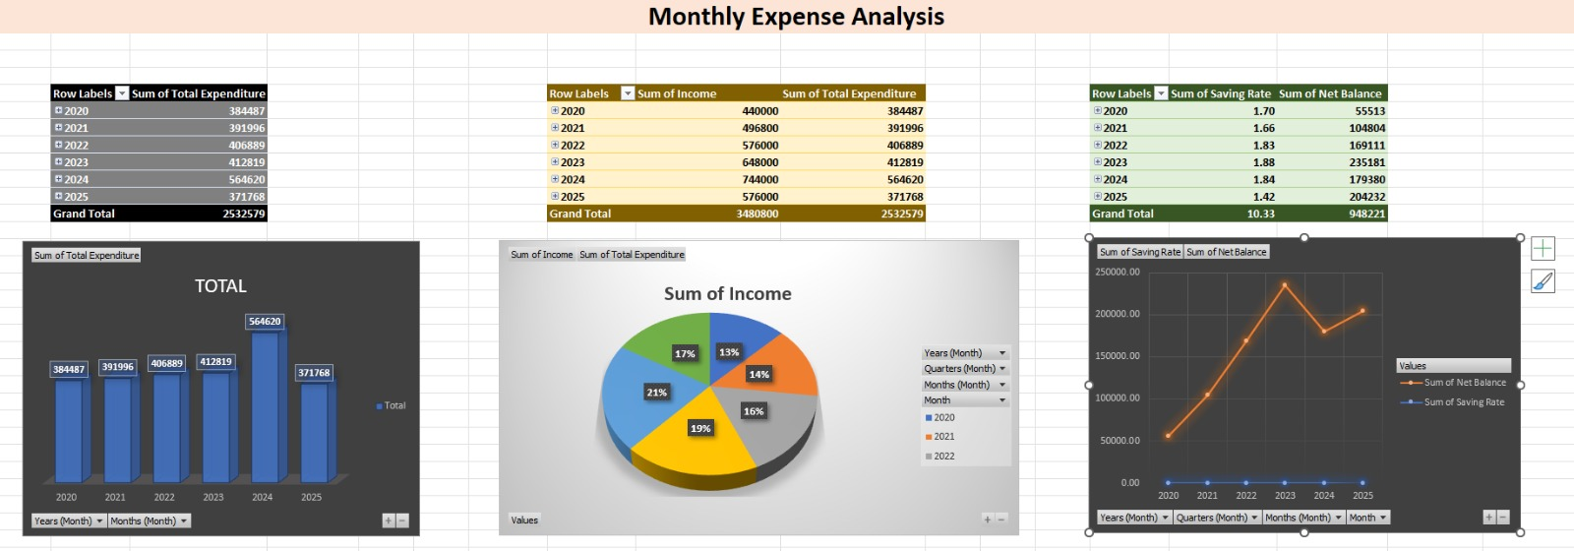
Project Demo

Slide 5

Future Scope
Develop an automated expense tracking system for regular data updates.
Create an interactive Excel Dashboard with filters and slicers.
Add budget planning and monthly spending limits.
Generate alerts when expenses exceed the planned budget.
Use historical data to identify long-term spending trends.
Integrate the system with Power BI or other data visualization tools for advanced analysis.
Expand the project into a mobile or web-based expense management application.

Slide 6

Conclusion
MS Excel provides an easy and effective way to analyse monthly expenses.
Categorizing expenses helps in understanding where money is being spent.
Charts and graphs make spending patterns and monthly changes easier to understand.
The analysis helps identify major expense categories and areas of high spending.
Overall, this project supports better expense tracking, budgeting, and financial planning.

Slide 7

Notes:
Thank You !!

